Slide 1
Lesson 1
Web Applications, Web Services & Service oriented Architecture

Slide 2
Session Learning Outcomes
At the end of this Topic, the learner should be able to:
Define the term web application
Differentiate between web 1, web 2and web 3
Explain the principles of web services and service oriented architecture
Describe the principles of REST as applied in web application design

Slide 3
History of the Internet & the Web
In 1969 the Advanced Research Projects Agency (ARPA), working for the US department of defense, developed ARPANET (Advanced Research Projects Agency Network).
ARPANET used NCP (Network Control Protocol) and originally connected US research centers and universities.
Later expanded to include other government sectors, more universities, and international hosts (Wikipedia 2016).
In 1981 the TCP/IP internet protocol, the replacement of NCP, was standardized, which changed ARPANET to The Internet.
This allowed any computer that supported this protocol to be networked together.

Slide 4

Tim Berners Lee
The standardization of TCP/IP changed ARPANET to The Internet.
This led to Tim Berners Lee to conceive the world wide web (WWW), and he went on to create the first web site running on the first web server in 1990.
The earliest web featured static web sites which could be viewed on a web browser that supported the early HTML specification.

Slide 5
Web 1.0
The first iteration of the web represents the web 1.0, which, according to Berners-Lee, is the “read-only web.”
In other words, the early web allowed us to search for information and read it.
There was very little in the way of user interaction or content generation.
An example might be a personal Web page that gives information about the site's owner, but never changes

Slide 6
Web 2.0
Then Web 2.0 came in.
Tim referred to it as the “read-write” web.
Users are no longer just consumers; they become producers or co-producers of contents.
Examples include Wikipedia, blogs, social networks and YouTube

Slide 7
Web 3.0
Combines the virtues of Web 1.0 and 2.0.
Adds machine intelligence.
Also known as the Semantic Web.
An extension of the existing World Wide Web, and it represents an effective means of data representation in the form of a globally linked database.
By supporting the inclusion of semantic content in Web pages, the Semantic Web targets the conversion of the presently available Web of unstructured documents to a Web of information/data.

Slide 8
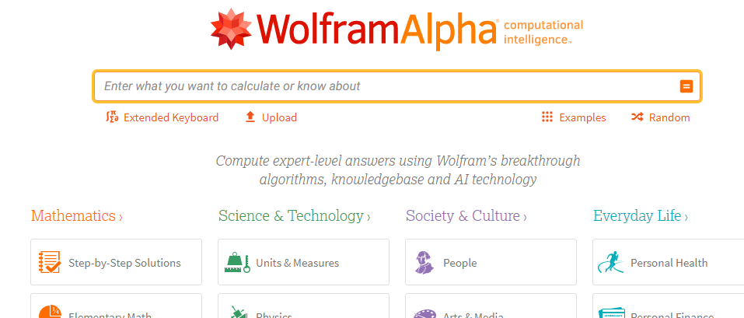
Web 3.0 Application Example
We can do a little comparison between Wolfram Alpha and Google, using both tools, typing the “Kenya vs. Uganda” phrase in both searching engines, and then we see big differences in the results:

Slide 9
Web Application Defn.
A Web application (Web app) is an application software that is stored on a remote server and delivered over the Internet through a browser interface.
For a web app to operate, it needs a Web server, application server and a database server.
Web servers manage the requests that come from a client.
Application server completes the requested task.
A database server can be used to store any needed information.

Slide 10





Examples of Web Applications

Slide 11
Web Services
What are they?

Slide 12
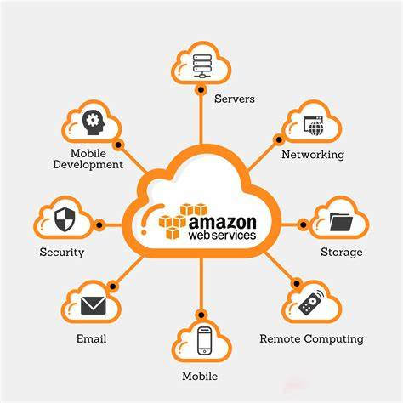
Amazon Web Services

Slide 13
Web Service Definition
A resource that’s made available over the internet.
A standardized medium to propagate communication between the client and server applications on the World Wide Web.
A software module which is designed to perform a certain set of tasks.
A common platform that allows multiple applications built on various programming languages to have the ability to communicate with each other.
An XML-centered data exchange system that use the internet for A2A (application-to-application) communication and interfacing.

Slide 14


Example of a Service: Ordering Food in a Chinese Restaurant
You(Client)
Waitress(Service)
Kitchen(Server)
You speak English only
Chef speaks Chinese
only
Speaks a language understood
By both client & Server

Slide 15
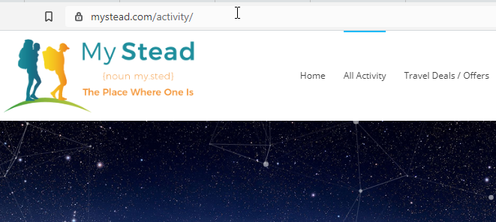
Web Services Case Study using mystead.com

Slide 16
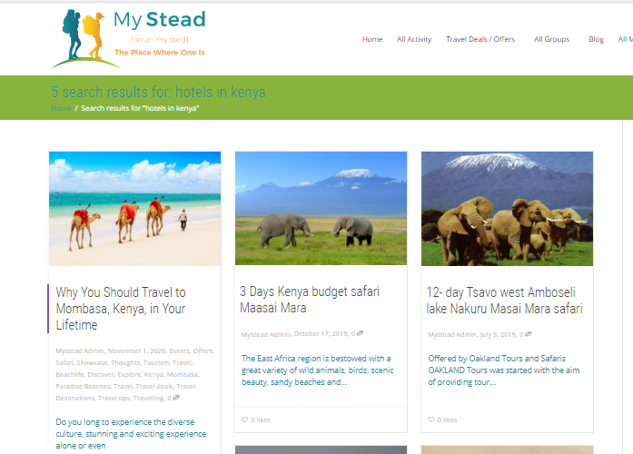
5 search results for: hotels in Kenya

Slide 17

8 search results for: AIR TRAVEL IN AFRICA

Slide 18
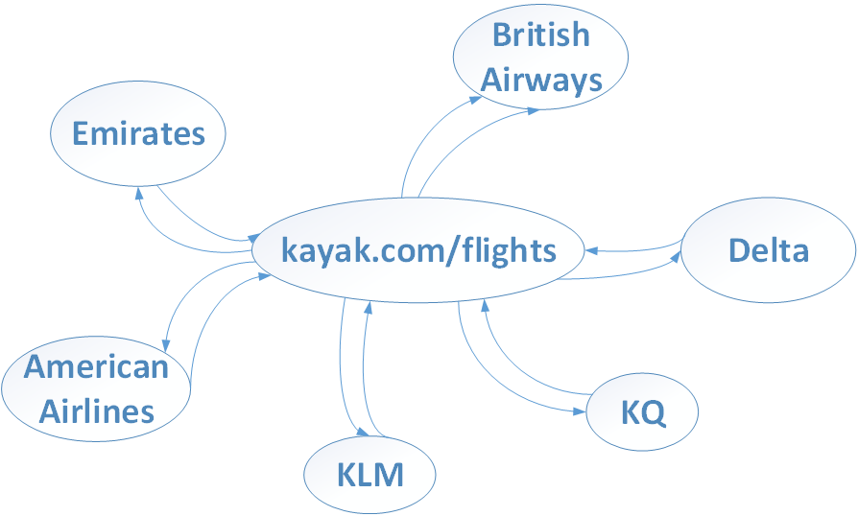
Booking a flight with kayak.com
https://www.kayak.com/flights/NBO-NYC/2019-10-14/2019-10-21?sort=bestflight_a
How is it possible for the database of kayak.com to query the databases of all the six flight companies and retrieve real time feedback?

Slide 19
Web Services Introduction
Is it possible that kayak.com application has access to the databases of the six flight web applications?
The answer is no.
No company will allow third parties to access their databases.

Slide 20
Web Services Introduction(cont.)
Are the six applications sending their data at say 20 minutes intervals to kayak.com?
Yes. That is possible. But………………..

Slide 21
Web Services Introduction(cont.)
The true position is that all these airlines have exposed their web services through an API.
Kayak.com uses those web services to communicate with the respective airlines.
Web services uses common format to send and receive messages between kayak.com and the other applications
All the responses received is shown on kayak.com

Slide 22
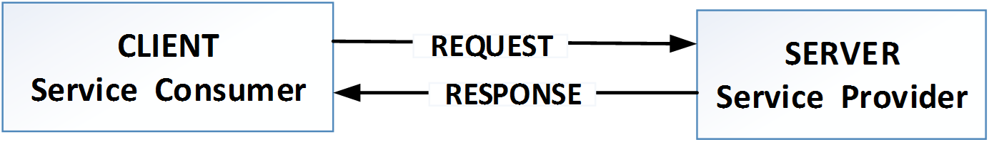
Service Provider & Consumer(cont.)
To enable COMMUNICATION between two applications.
SERVICE PROVIDER-Creator of web services
Develops and implements the application(web service) and makes it available over the internet.
SERVICE CONSUMER-Client

Slide 23
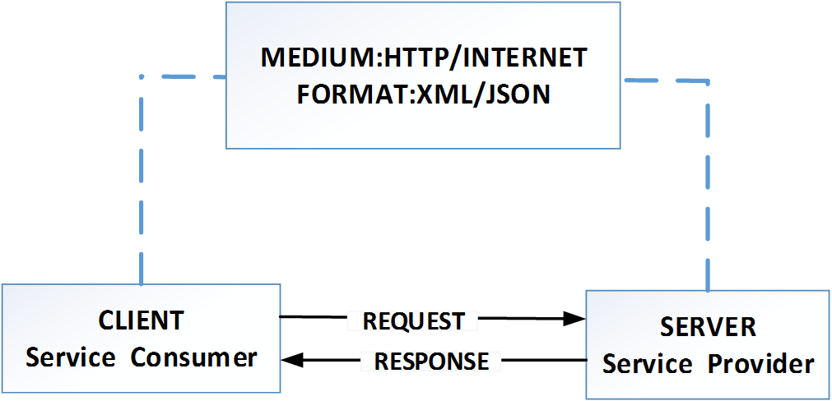
Service Provider & Consumer(cont.)
EXAMPLE: While speaking to your friend over telephone, Medium is the phone and format is the common language(e.g English) that both of you can understand

Slide 24
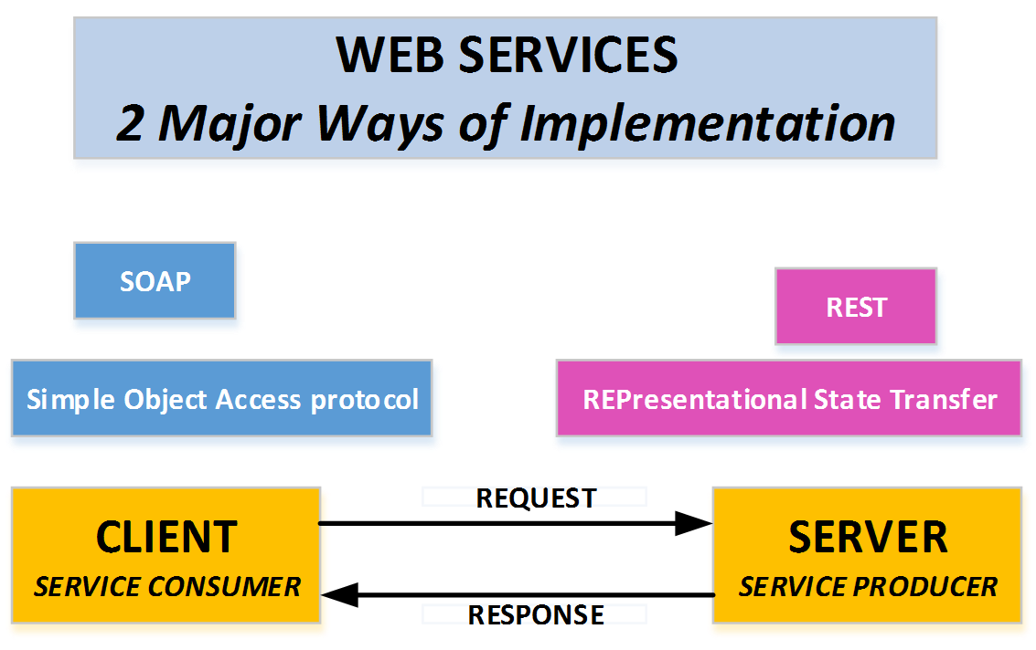
Web Service Implementation Protocols

Slide 25
Web Service Implementation Protocols(cont.)
SOAP:Simple Object Transfer Protocol
Medium:HTTP(POST)
Format: XML
REST:REpresentational State Transfer
Medium:HTTP(POST,GET PUT,DELETE)
Format:XML/JSON

Slide 26
REST
REST is a term coined by Roy Fielding in 2000.
An an acronym for REpresentational State Transfer.
An architecture style for designing loosely coupled applications over HTTP, that is often used in the development of web services.
A web service that communicates/exchanges information between two applications using REST architecture principles is called a RESTful web service.

Slide 27
REST Principles
REST defines a set of principles/constraints to be followed while designing a service for communication/data exchange between two applications.
When these principles are applied while designing web services(for client-server interactions), we get a RESTful Web Service.
Principles/Constraints.
Client -Server
Uniform interface
Stateless
Cacheable
Layered System

Slide 28
1. Client–Server
By separating the user interface concerns from the data storage concerns, we improve the portability of the user interface across multiple platforms and improve scalability by simplifying the server components.
This constraint essentially means that client application and server application MUST be able to evolve separately without any dependency on each other.
A client should know only resource URIs, and that’s all.

Slide 29
2. Stateless
No client context shall be stored on the server between requests. The client is responsible for managing the state of the application.
Statelessness means that every HTTP request happens in complete isolation.
Each request from client to server must contain all of the information necessary to understand the request, and cannot take advantage of any stored context on the server.
Session state is therefore kept entirely on the client..

Slide 30
2. Statelessness
No client context shall be stored on the server between requests. The client is responsible for managing the state of the application.
Statelessness means that every HTTP request happens in complete isolation.
When the client makes an HTTP request, it includes all information necessary for the server to fulfill that request.
The server never relies on information from previous requests.
If that information was important, the client would have sent it again in this request.
Each request from client to server must contain all of the information necessary to understand the request, and cannot take advantage of any stored context on the server.
Session state is therefore kept entirely on the client..

Slide 31
Statelessness Example
If a person is adding items to his cart in shopping website, the state of the cart should be stored at the clients side only.
And this state of the cart has to be sent from the client to the server whenever required
Because the server does not have the overhead of storing or maintaining the session, statelessness improves the web service performance

Slide 32
3.Caching
Caching is the ability to store copies of frequently accessed data in several places along the request-response path.
When a consumer requests a resource representation, the request goes through a cache or a series of caches (local cache, proxy cache or reverse proxy) toward the service hosting the resource.
If any of the caches along the request path has a fresh copy of the requested representation, it uses that copy to satisfy the request.
If none of the caches can satisfy the request, the request travels all the way to the service (or origin server as it is formally known).

Slide 33
3.Caching(cont.)
Well-managed caching partially or completely eliminates some client-server interactions, further improving scalability and performance.

Slide 34
Caching Benefits
Optimizing the network using caching improves the overall quality-of-service in following ways:
Reduce bandwidth
Reduce latency
Reduce load on servers
Hide network failures

Slide 35
Uniform Interface
In order to obtain a uniform interface, multiple architectural constraints are needed to guide the behavior of components.
RESTful basically works on the HTTP web layer and uses the below key verbs or interfaces to work with resources on the server
POST - To create a resource on the server
GET - To retrieve a resource from the server
PUT - To change the state of a resource or to update it
DELETE - To remove or delete a resource from the server

Slide 36
Uniform Interface(cont.)
Also, the resource representations across system should follow certain guidelines such as naming conventions, link formats or data format (xml or/and json).
All resources should be accessible through a common approach such as HTTP GET and similarly modified using a consistent approach.

Slide 37
Layered system
The layered system style allows an architecture to be composed of hierarchical layers by constraining component behavior such that each component cannot “see” beyond the immediate layer with which they are interacting.
REST allows you to use a layered system architecture where you deploy the APIs on server A, and store data on server B and authenticate requests in Server C, for example. A client cannot ordinarily tell whether it is connected directly to the end server or an intermediary along the way.

Slide 38
What is Software Architecture?
a structured framework used to conceptualize software elements, relationships and properties.
A structure that describes software's major components, their relationships (structures), and how they interact with each other.
A good SA optimizes security, performance and overall quality of software.

Slide 39
Client Server Architecture
Most of the web applications are based on client server architecture.
Client: Client process is requester of the service or information.
Example: Browser, Online chat client, Email client etc.
Server: Server process accepts the request of the client, performs the processing, gathers the required information.
Example: Print server, Web server, Database server, chat server, FTP server etc.
Medium of communication of client and server:
It defines the path by which client and server communicate with each other. E.g.-Internet, Intranet, Bluetooth network etc.

Slide 40
Software Architecture Benefits
Serves as a blueprint for a system by providing an abstraction to manage the system complexity.
It defines a structured solution to meet all the technical and operational requirements, while optimizing the common quality attributes like performance and security.
Helps in building a quality, maintainability, performance oriented and the overall success of the final product.

Slide 41
Difference between Architecture & Design.
Software Architecture focuses more on the interaction between the externally visible components of the system where as the Design is about how the internal components of the system interact with each other.
Software Architecture is concerned with issues beyond the data structures and algorithms used in the system

Slide 42
Software Pattern vs Architectural Style
Software may use a pattern or an architectural style.
A pattern is a reusable solution for any problem faced during software design and development.
An architectural style is the structure of the software based on which design pattern it is created.

Slide 43
Layered/Tiered Architecture
An improvement over the client/server architecture pattern.
Most commonly used architectural pattern.
comprises of three or more layers: presentation/user interface layer, business logic layer, and data persistence layer.
Uses model view controller (MVC) pattern to simplify web applications
Main advantage is the separation of concerns that is each layer can focus solely on its role and responsibility.

Slide 44
Component Based Architecture
CBA focuses on the decomposition of the design into individual functional or logical components that represent well-defined communication interfaces containing methods, events, and properties.
The primary objective of component-based architecture is to ensure component reusability.
A component encapsulates functionality and behaviors of a software element into a reusable and self-deployable binary unit.
As the software architecture is formulated, components are selected from the library and used to populate the architecture.

Slide 45
Service-Oriented Architecture (SOA)
Service-Oriented Architecture (SOA) is an architectural approach in which applications make use of web services available in the network.

Slide 46
SOA-cont.
Defn1:Service-Oriented Architecture (SOA) is an architectural approach in which applications make use of services available in the network.
Service Oriented Architecture, as the name says is an architectural concept which focuses on having different services communicating with each other to carry out tasks.
Thus, a web service is a basic building block in a SOA.
SOA puts together application packages into a set of interoperable services, which can be integrated into different software systems belonging to separate business domains.
When multiple services are combined, we have an application that falls under SOA.

Slide 47
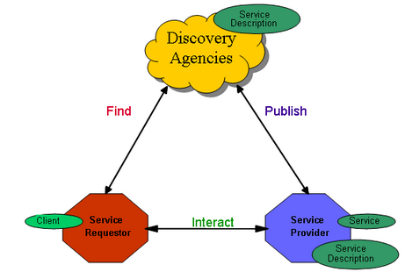
SOA

Slide 48
SOA provider & Consumer
There are two major roles within Service-oriented Architecture:
Service provider: The service provider is the maintainer of the service and the organization that makes available one or more services for others to use.
To advertise services, the provider can publish them in a registry, together with a service contract that specifies the nature of the service, how to use it, the requirements for the service, and the fees charged.
Service consumer: The service consumer can locate the service metadata in the registry and develop the required client components to bind and use the service..

Slide 49
Micro Services
Micro services, or micro service architecture, is an approach to application development in which a large application is built as a suite of modular components or services.
a service-oriented architecture pattern wherein applications are built as a collection of various smallest independent service units.
MSA focuses on decomposing an application into single-function modules with well-defined interfaces.
These modules can be independently deployed and operated by small teams who own the entire lifecycle of the service.

Slide 50
SOA vs. Microservices
Parameter | SOA | Microservices
Design type | In SOA, software components are exposed to the outer world for usage in the form of services. | Micro Service is a part of SOA. It is an implementation of SOA.
Dependency | Business units are dependent. | They are independent of each other.
Size of the Software | Software size is larger than any conventional software | The size of the Software is always small in Microservices
Technology Stack | The technology stack is lower compared to Microservice. | Microservice technology stack could be very large
Nature of the application | Monolithic in nature | Full stack in nature
Independent and Focus | SOA applications are built to perform multiple business tasks. | They are built to perform a single business task.
Deployment | The deployment process is time- consuming. | Deployment is straightforward and less time-consuming.
Cost - effectiveness | More cost-effective. | Less cost-effective.
Scalability | Less compared to Microservices. | Highly scalable.
Business logic | Business logic components are stored inside of single service domain Simple wire protocols(HTTP with XML JSON) API is driven with SDKs/Clients | Business logic can live across domains enterprise Service Bus like layers between services Middleware

Slide 51
The end Thank you

